Slide 1


HILLARY IANTOSCA
EXPLORING TECHNICAL WRITING TOOLS
FINAL PROJECT | MCC SPRING 2024

Slide 2

CONTENT
01
INTRODUCTION
02
OVERVIEW OF TECHNICAL WRITING TOOLS
03
FAVORITE TOOL - MARKDOWN
04
LEAST FAVORITE TOOL - MICROSOFT POWERPOINT
05
CONCLUSION
06
Q&A
07
THANK YOU!

Slide 3
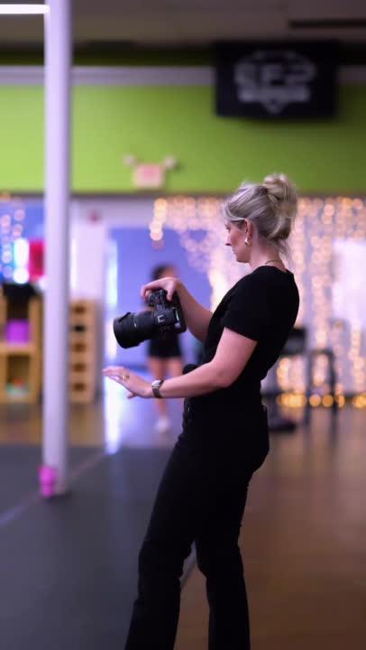
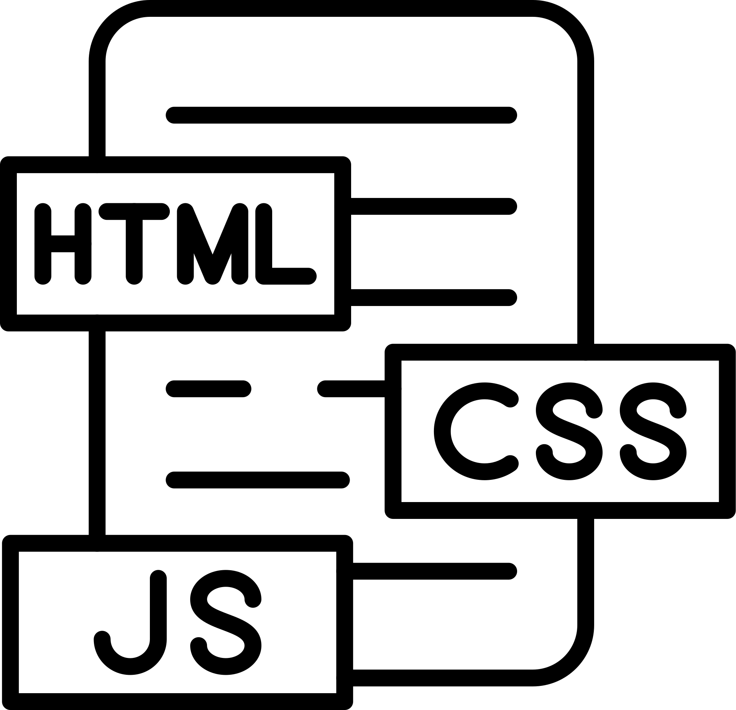


INTRODUCTION
Presenter:
Hillary Iantosca
Presentation Date:
04/09/2024
About me:
Photographer, writer, educator, athlete & musician
Homebase:
Raleigh N.C.

Slide 4

OVERVIEW OF TECHNICAL WRITING TOOLS
MS POWERPOINT
NOTEPAD++
MS WORD
MARKDOWN
OXYGEN
FRAMEMAKER
MADCAP FLARE
RESTRUCTURED TEXT

Slide 5


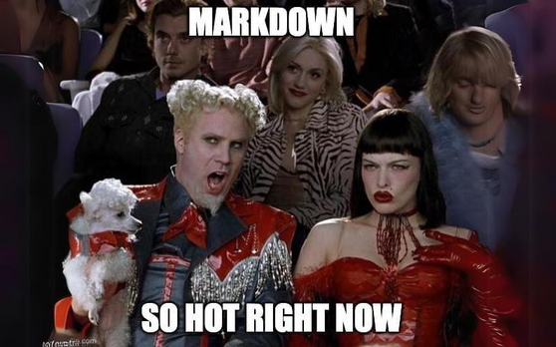
FAVORITE TOOL - MARKDOWN
WHY I LIKE MARKDOWN:
Lightweight and easy syntax
Great for clean, structured documents
Supports multiple output formats
Standalone and vast support resources
PRACTICAL APPLICATIONS:
Writing project README files on GitHub
Creating technical documentation
Collaborating on documentation using version control

Slide 6
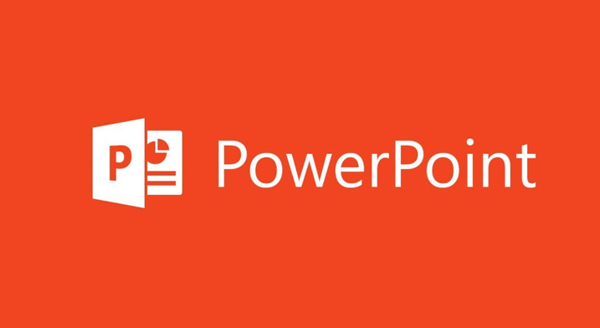
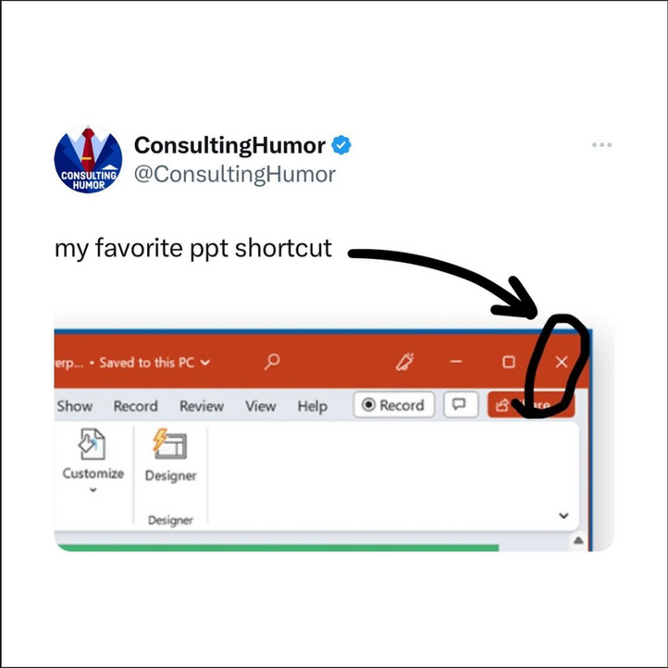
LEAST FAVORITE TOOL - MS POWER POINT
WHY I DISLIKE MS POWER POINT:
Hinders content depth with slide dependence
Limited flexibility for detailed documentation
Often used for presentations over technical writing
PRACTICAL APPLICATIONS:
Creating visual aids and slide decks
Standard tool for sharing information in corporate settings
Effective for summarizing technical content in meetings

Slide 7
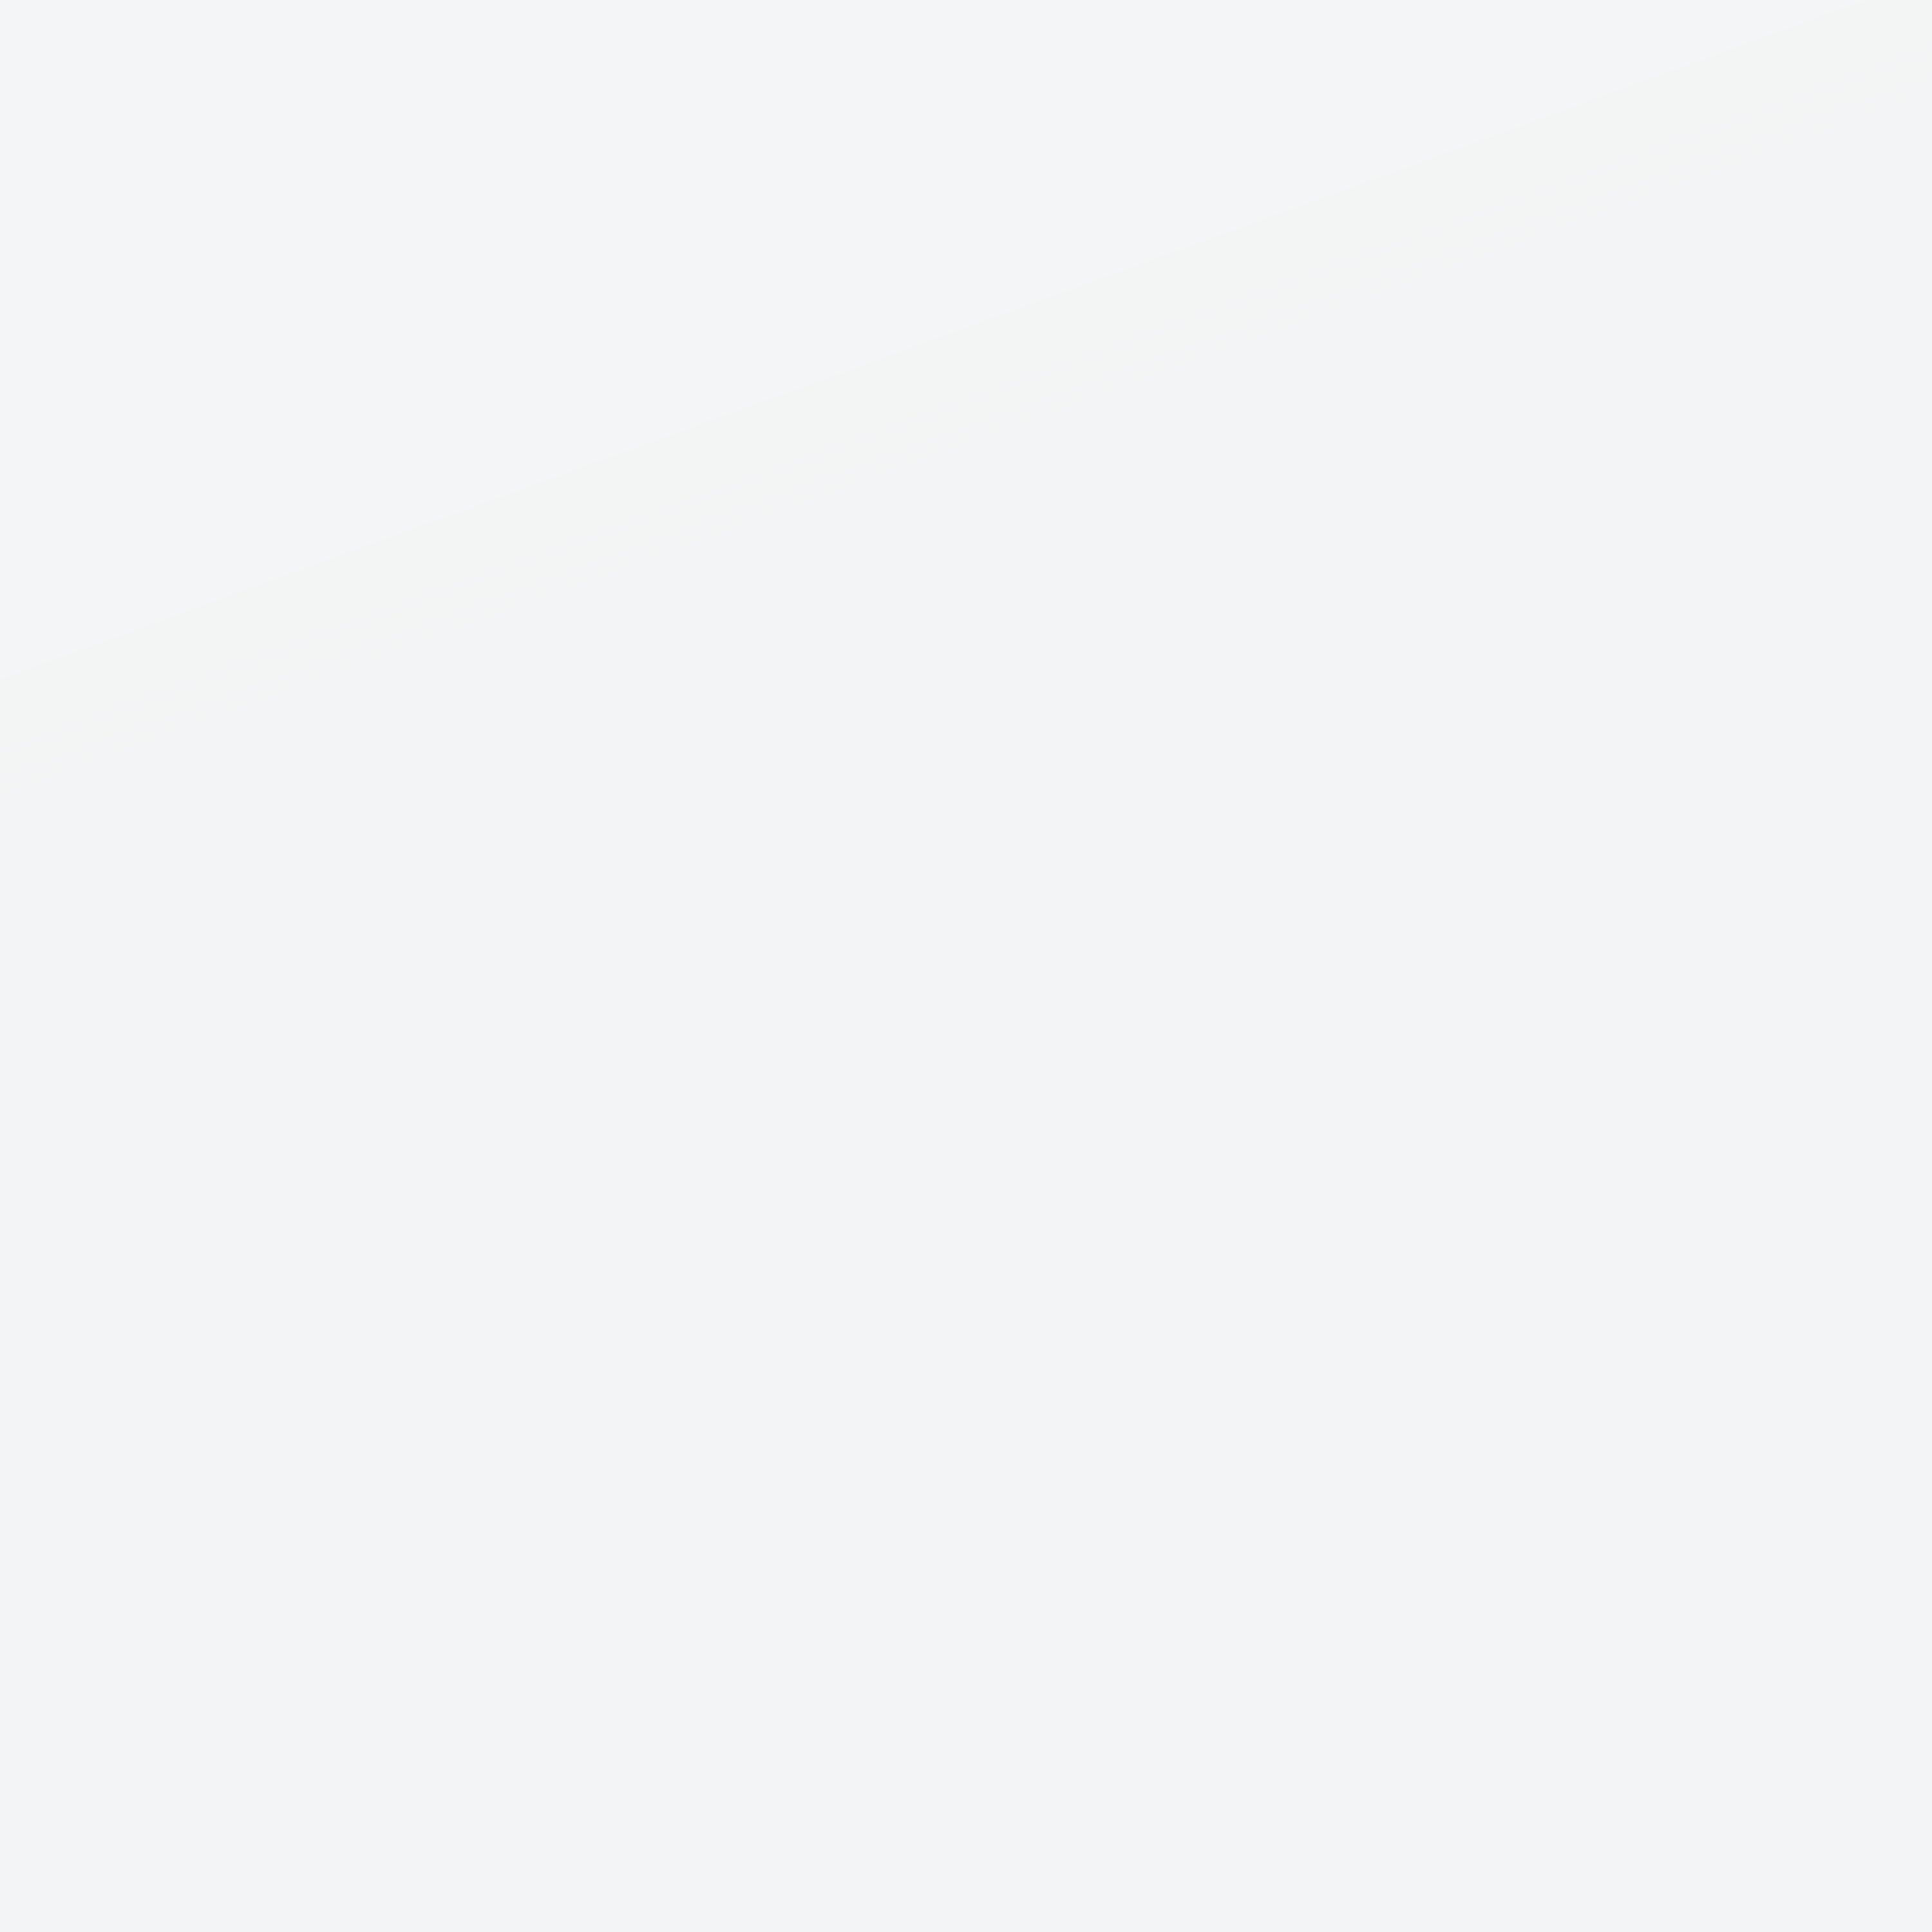

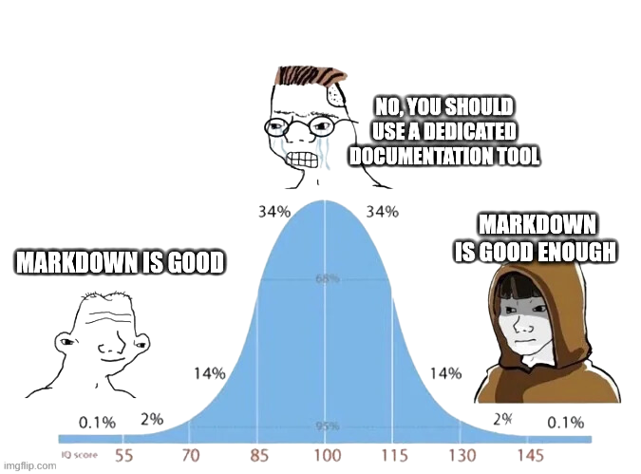
CONCLUSION
Use the right tool for the job
Emphasis on collaboration
[Con]version management
User-centered design

Slide 8

Q&A
Questions & Discussion

Slide 9

THANK YOU!

